Slide 1


EE463-Term Project Kardeşler Elektronik A.Ş.
#since1998
Emin Ün 2167476
Enes Canbolat 2231546
Berkay Uzun 2263812

Slide 2
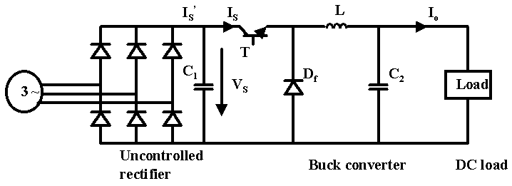
Rectifier + Buck Converter
TOPOLOGY SELECTION

Slide 3
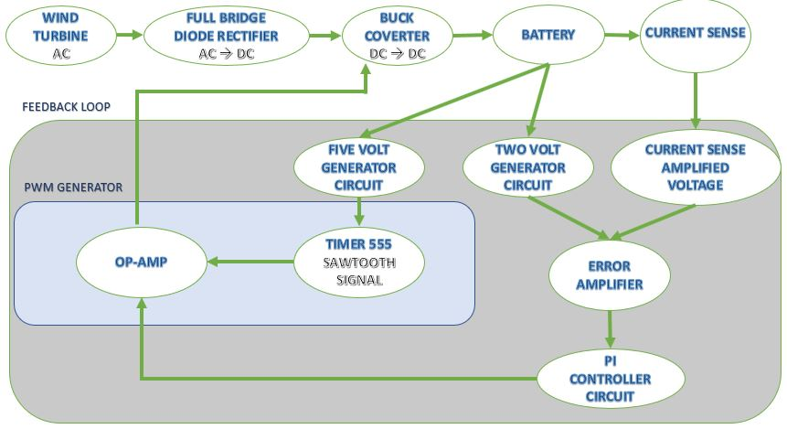
Block Diagram
CIRCUIT DESIGN AND SIMULATION RESULTS
Notes:
Block diagram

Slide 4
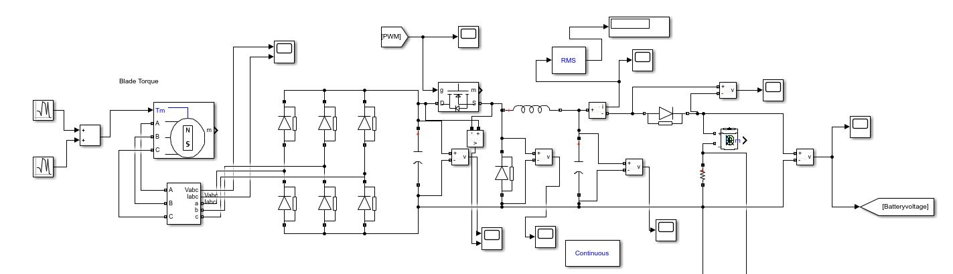
Main Block
CIRCUIT DESIGN AND SIMULATION RESULTS
Notes:
Main block

Slide 5
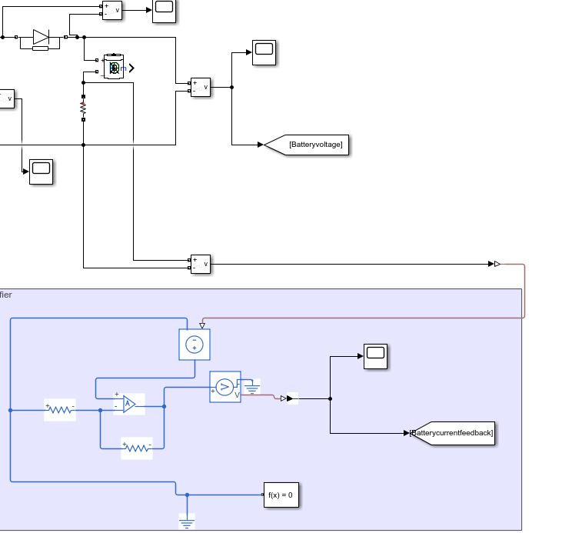
Current Sense & Amplifier
CIRCUIT DESIGN AND SIMULATION RESULTS
Notes:
Current Sense and Amplifier

Slide 6
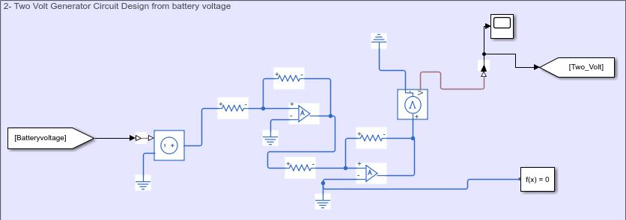
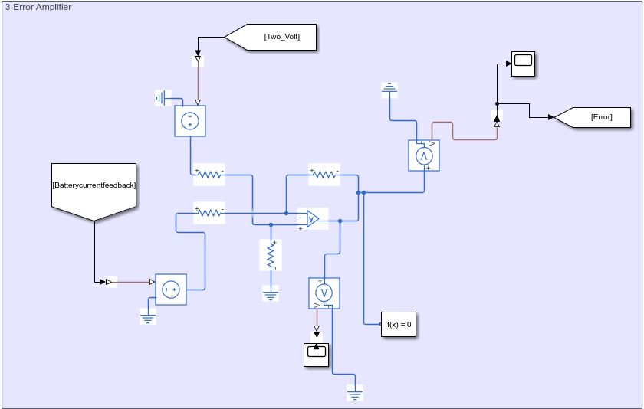
2 & 5 Volt Generation
CIRCUIT DESIGN AND SIMULATION RESULTS
Error Amplifier
Notes:
Error Amplifier and 2&5 Volt Generator

Slide 7
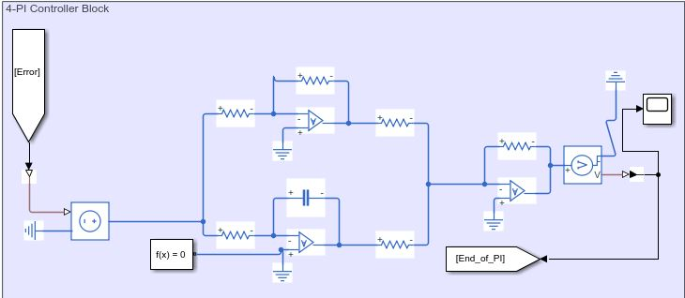
PI Controller Block
CIRCUIT DESIGN AND SIMULATION RESULTS
Notes:
PI Controller Block

Slide 8
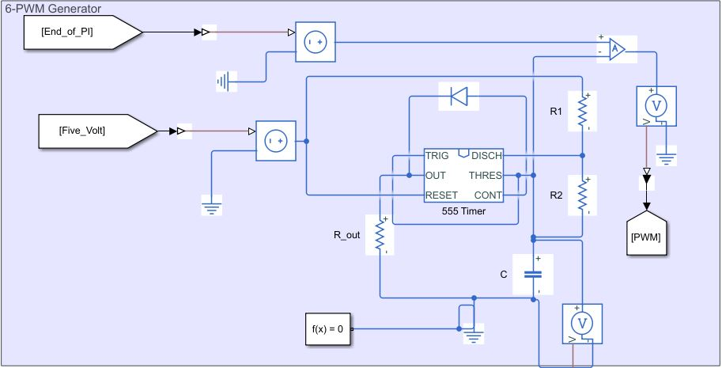
PWM Generator
CIRCUIT DESIGN AND SIMULATION RESULTS
Notes:
PWM Generator

Slide 9
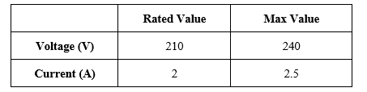
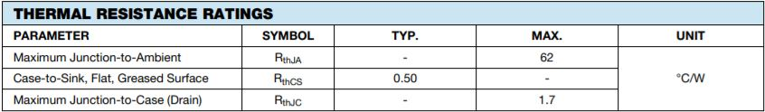


MOSFET Selection
COMPONENT SELECTION
Thermal Analysis

Slide 10
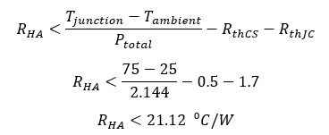

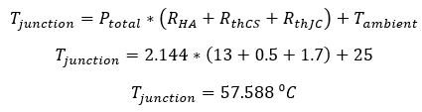
Heatsink Selection
COMPONENT SELECTION
Thermal Resistance : 13⁰C/W
Size : 12.3x29x35mm (LxWxH)
Suitable with TO220:
Notes:
Çalışma sıcaklığını 75 dereceye düşürmek için heatsinkin gerekli olan maksimum termal direnci

Slide 11
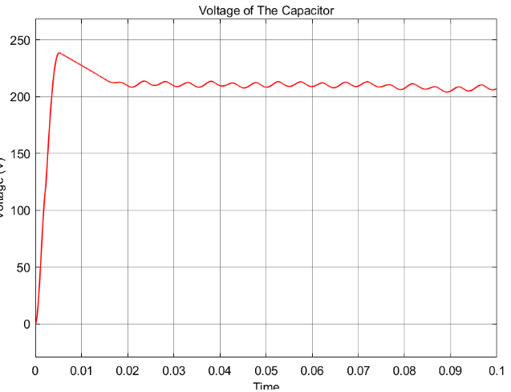
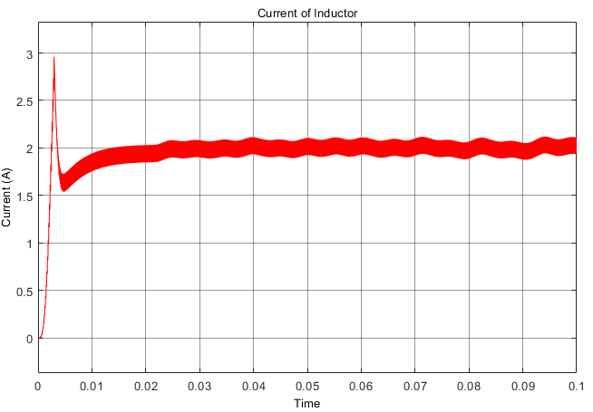
Capacitor Selection
COMPONENT SELECTION
Inductor Selection

Slide 12
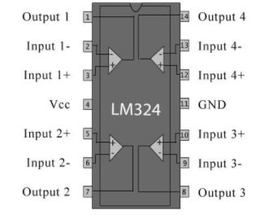
Op-Amp Selection
COMPONENT SELECTION
Resistor Selection
Much Cheaper
Physically Durable
Variety of Resistance Value

Slide 13
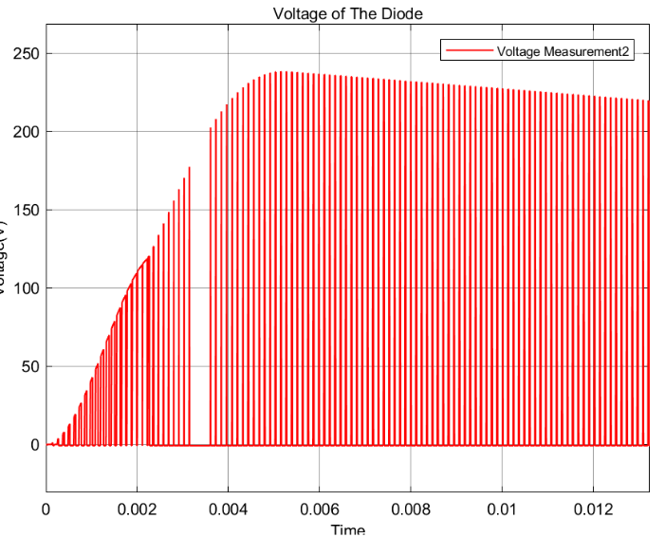
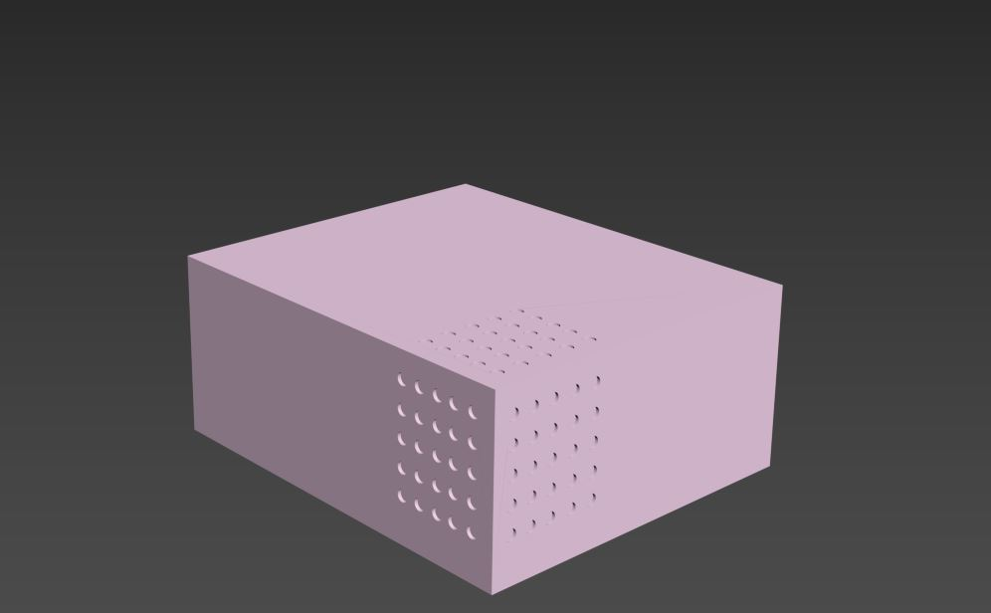
Diode Selection
COMPONENT SELECTION
Box Design

Slide 14
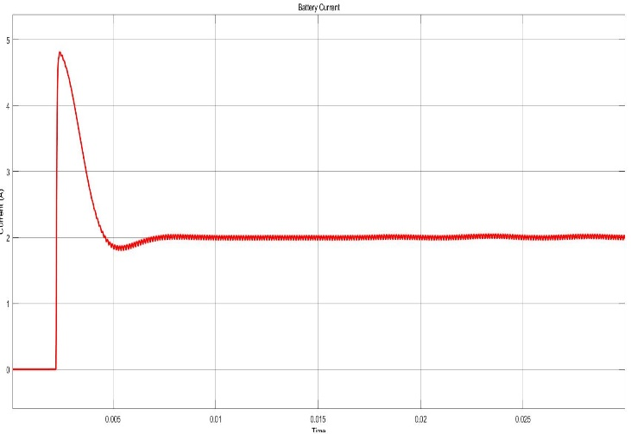
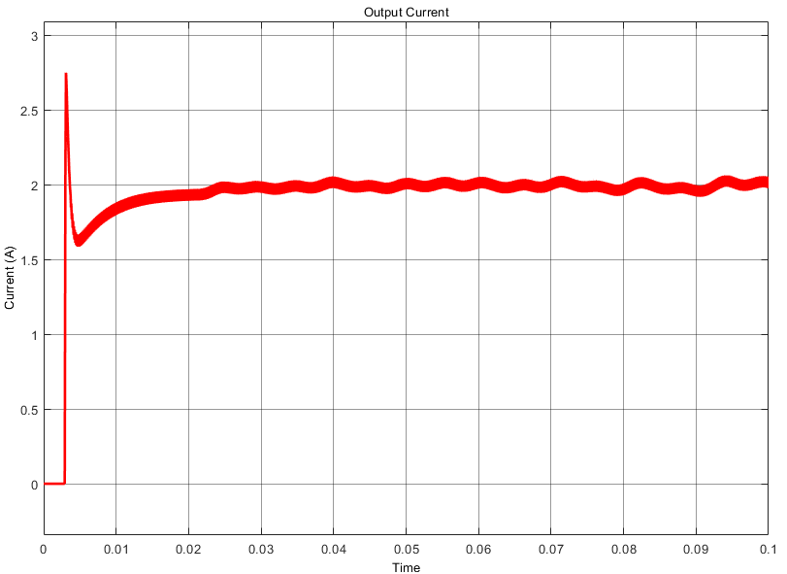
Before
PERFORMANCE OF DESIGN
After

Slide 15
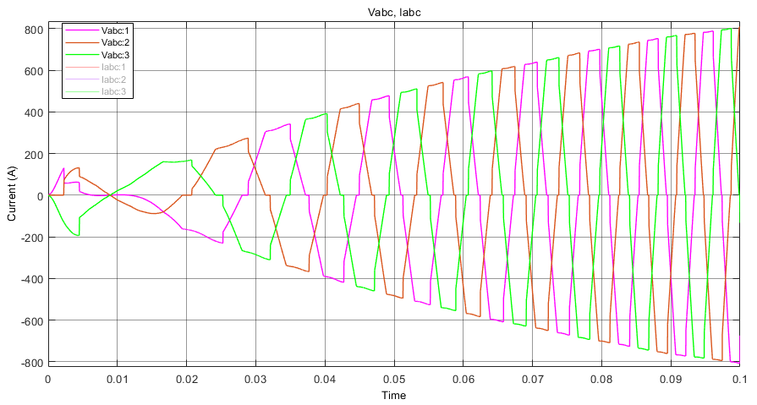
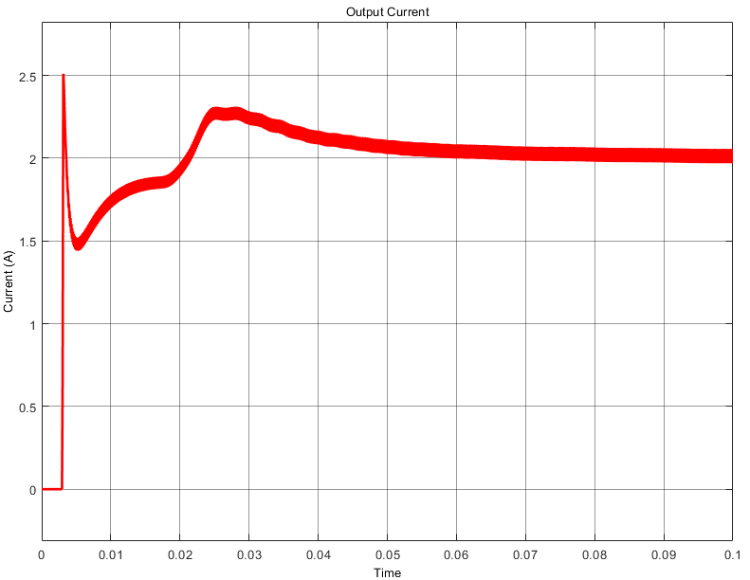
High Input Voltage
PERFORMANCE OF DESIGN

Slide 16
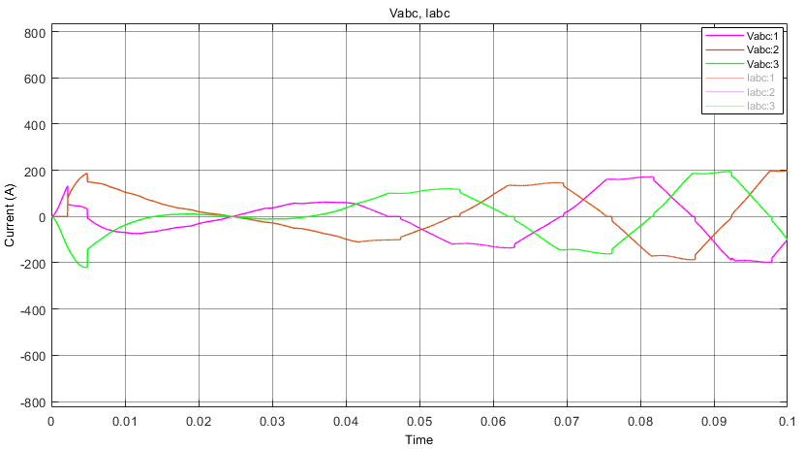
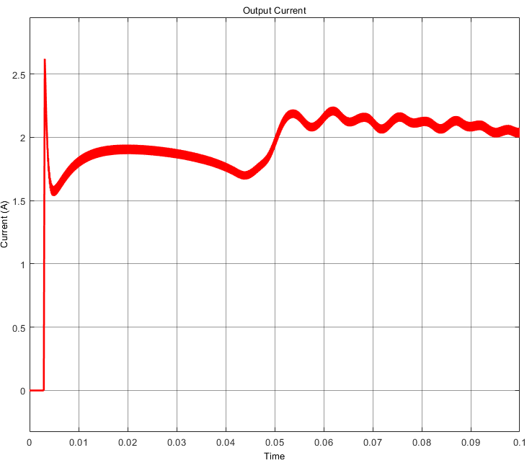
Low Input Voltage
PERFORMANCE OF DESIGN

Slide 17
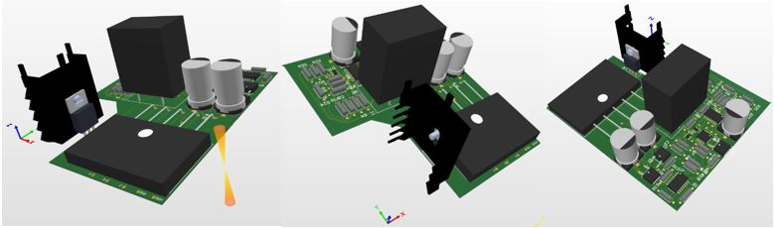
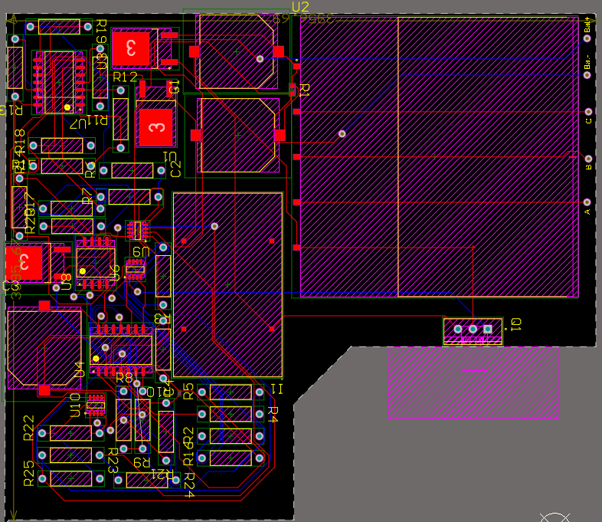
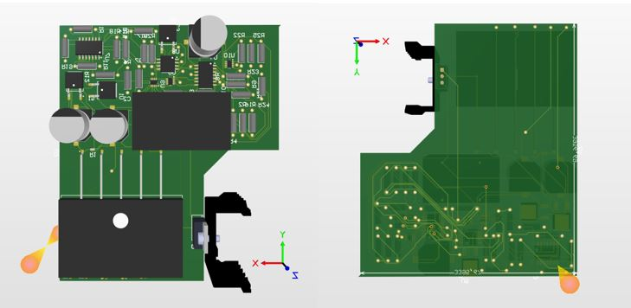
PCB DESIGN

Slide 18
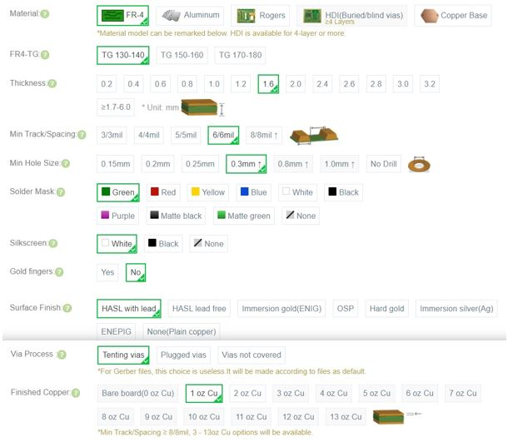

COST ANALYSIS

Slide 19
Component | Rated Value | Place in the Circuit | Type of the Component | Manufacturer | Serial Number | Unit Price ($) | Total Price ($)
Resistors (Ω) | 0.25 | Current Sense | Chip Resistor - Surface Mount | Venkel | LCR0603-R250FT | 0.03062 | 30.62
 | 1k | 2 Volt Generator | CARBON FILM RESISTOR | KOA Speer Electronics, Inc. | CF1/4C102J | 0.011 | 11
 | 5.1k |  | CARBON FILM RESISTOR | KOA Speer Electronics, Inc. | CFS1/4CT52R512J | 0.00848 | 8.48
 |  |  | CARBON FILM RESISTOR | KOA Speer Electronics, Inc. | CFS1/4CT52R512J | 0.00848 | 8.48
 | 12k |  | CARBON FILM RESISTOR | KOA Speer Electronics, Inc. | CF1/4CT52R123J | 0.011 | 11
 | 560 | 5 Volt Generator | CARBON FILM RESISTOR | KOA Speer Electronics, Inc. | CF1/2CT52R561J | 0.01738 | 17.38
 | 2.7k |  | CARBON FILM RESISTOR | KOA Speer Electronics, Inc. | CF1/2CT52R272J | 0.01738 | 17.38
 | 5.1k |  | CARBON FILM RESISTOR | KOA Speer Electronics, Inc. | CFS1/4CT52R512J | 0.00848 | 8.48
 |  |  | CARBON FILM RESISTOR | KOA Speer Electronics, Inc. | CFS1/4CT52R512J | 0.00848 | 8.48
 | 240 | Amplifier | CARBON FILM RESISTOR | KOA Speer Electronics, Inc. | CF1/2CT52R241J | 0.01738 | 17.38
 | 1.2k |  | CARBON FILM RESISTOR | KOA Speer Electronics, Inc. | CF1/4CT52R122J | 0.011 | 11
 | 1.2k | Error Amplifier | CARBON FILM RESISTOR | KOA Speer Electronics, Inc. | CF1/4CT52R122J | 0.011 | 11
 | 3.3k |  | CARBON FILM RESISTOR | KOA Speer Electronics, Inc. | CF1/4CT52R332J | 0.011 | 11
 | 5.1k |  | CARBON FILM RESISTOR | KOA Speer Electronics, Inc. | CFS1/4CT52R512J | 0.00848 | 8.48
 |  |  | CARBON FILM RESISTOR | KOA Speer Electronics, Inc. | CFS1/4CT52R512J | 0.00848 | 8.48
 | 680 | PI Controller | CARBON FILM RESISTOR | KOA Speer Electronics, Inc. | CFS1/4CT52R681J | 0.00848 | 8.48
 | 820 |  | CARBON FILM RESISTOR | KOA Speer Electronics, Inc. | CF1/2CT52R821J | 0.01738 | 17.38
 |  |  | CARBON FILM RESISTOR | KOA Speer Electronics, Inc. | CF1/2CT52R821J | 0.01738 | 17.38
 | 2.2k |  | CARBON FILM RESISTOR | KOA Speer Electronics, Inc. | CF1/2CT52R222J | 0.01738 | 17.38
 | 8.6k |  | CARBON FILM RESISTOR | Stackpole Electronics Inc | RNF18FTD8K60 | 0.0085 | 8.5
 | 5.6k |  | CARBON FILM RESISTOR | KOA Speer Electronics, Inc. | CF1/4CT52R562J | 0.011 | 11
 | 1.2k | Timer | CARBON FILM RESISTOR | KOA Speer Electronics, Inc. | CFS1/4CT52R122J | 0.00848 | 8.48
 | 3.3k |  | CARBON FILM RESISTOR | KOA Speer Electronics, Inc. | CF1/4CT52R332J | 0.011 | 11
 | 100k |  | CARBON FILM RESISTOR | KOA Speer Electronics, Inc. | CF1/2CT52R104J | 0.01738 | 17.38
COST ANALYSIS

Slide 20
Component | Rated Value | Place in the Circuit | Type of the Component | Manufacturer | Serial Number | Unit Price ($) | Total Price ($)
Capacitors (F) | 100µF | Buck Converter | Aluminum Electrolytic | Illınois Capacitor | 107RZM05 | 0.15351 | 153.51
 | 100µF | Filter | Aluminum Electrolytic | United Chemi-Con | EKXJ221ELL101MK25S | 0.71258 | 712.58
 | 5µF | PI Controller | Aluminum Electrolytic | Vishay Sprague | TE1404 | 1.5636 | 1563.6
 | 1nF | Timer | Ceramic | Yageo | CC0100KRX5R4BB102 | 0.01475 | 14.75
Inductor (H) | 15mH | Buck Converter | Fixed RING CORE CHOKE | EPCOS/TDK | 871-B82724J8302N040 | 2.9524 | 2952.4
MOSFET | 240V (max), 210V(Rated); 5A (max), 2A (Rated) | Buck Converter | N-MOSFET | Vishay Siliconix | IRFBC30APBF | 1.386 | 1386
Diodes | Not Applicable | Rectifier (6) | Bridge Rectifier | Micro Commercial Components | 833-3GBJ3516-BP | 16.8432 | 16843.2
 |  | Buck Converter | Schottky Diode | Wolfspeed / Cree | 941-C6D04065E | 0.89177 | 891.77
 |  | Before the battery | Schottky Diode | Vishay General Semiconductor | 78-V8PAM10S-M3/H | 0.15246 | 152.46
 |  | Timer | IC OSC SINGLE TIMER | Texas Instruments | 296-1857-5-ND | 0.3584 | 358.4
LM324 (x2) | Not Applicable | 2 Volt Generator (2 OP-APM) 5 Volt Generator (2 OP-APM) PI Controller (3 OP-AMP) Error Amplifier (1 OP-AMP) | QUADRUPLE OP-AMP | Texas Instruments | 595-LM324KADR | 0.363 | 363
OP-AMP | Not Applicable | Timer | Operational-Amplifier | NJR | 513-NJU7067M-TE2 | 0.09075 | 90.75
OP-AMP | Not Applicable | Current Sense | Operational-Amplifier | Texas Instruments | 595-OPA2990IDDFR | 0.69454 | 694.54
PCB | Not Applicable | Not Applicable | Not Applicable | PCBWay | Not Applicable | 1.022 | 1022
TOTAL COST = |  |  |  |  |  | 27.19896 | 27198.96
COST ANALYSIS

Slide 21


